Slide 1
Flood - IT
“Where colors spread fast and smart choices matter more.”

Slide 2
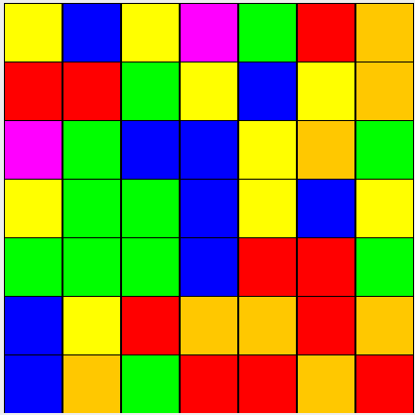
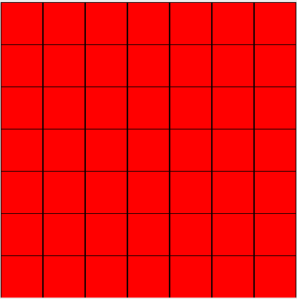
Main Goal and Rules to play.
Aim:-
Your goal is to fill the entire board with a single color in the fewest possible moves.
Rules to play:-
The game always starts from the top-left cell (0,0). Every move changes the color of this starting region spreads (floods) to all connected cells of the same color.

Slide 3

What is Divide & Conquer?
Divide the problem into smaller subproblems
if (r1 == r2 && c1 == c2)
Each subproblem should have atleast one cell
Solve each subproblem recursively
Frequency count of the particular color
Combine the results

Slide 4


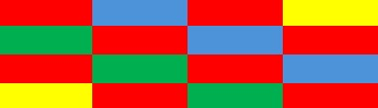


Divide & Conquer Concept
1.Initial grid.
q1
q2
q3
q4
Dividing into Subproblems

Slide 5
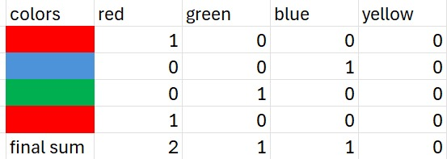
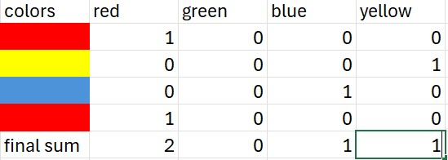
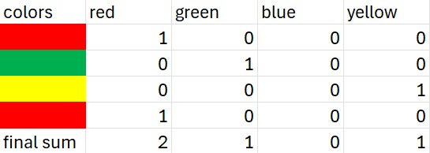
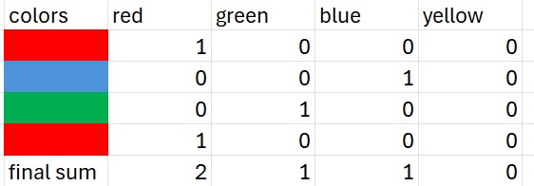
Solve each subproblem recursively

Slide 6
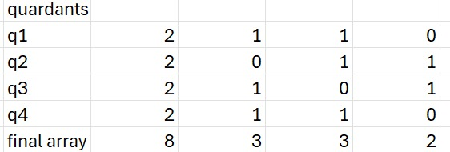
Combine the results

Slide 7
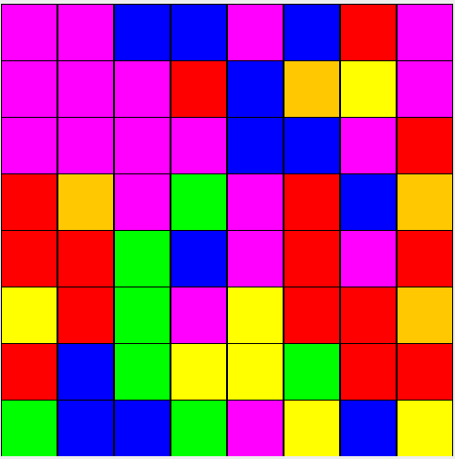
How to Get the Best color
Step 1: Finding the current flood region and marking as true.
Get current color
→ currentColor = grid[0][0]
Mark the current Flood region as true through Bfs
Finding the neighbor by incrementing the x and y coordinates
If the connected component color is same as old color then mark as true and store in the queue.
Step 2: Finding the Neighbours
After computing the flood region then the region is passed to find the neighbouring components of the updated flood.
If the neighbouring color should be inside the grid within the bounded part and should not match to the original flood color,then mark this color as true in an array.
Initially all the neighbour colors set as false

Slide 8
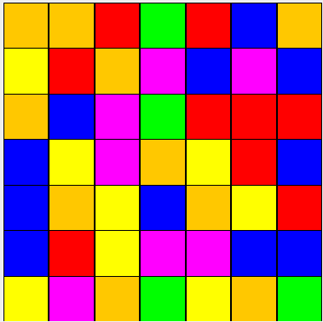
Greedy Strategy
Step 3: Pick the best color
• Initialize best = -1, max = -1
• Check all neighbor colors
→ If color ≠ current and has higher count
→ Update best color
• If best found → return it
• Else check all colors globally
→ Pick color with maximum count
• Return best color

Slide 9
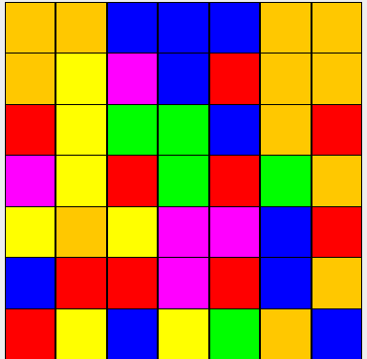
Examples of Possible cases
Case 1 — Neighbour exists AND it is also global maximum
Case 2 – Neighbour exists but NOT global maximum

Slide 10
Difference Between Previous Code & Present Code
Previous Code (BFS + Bucket Sort)
1) Breadth First Search (BFS)
Uses Queue
Explores layer by layer
Good for minimum-step problems
Safe from deep recursion
2) Bucket Sort Idea
Uses array like:
int colorCount[6]
Each index = one color
Count frequency
Pick maximum

Slide 11
Difference Between Previous Code & Present Code
Current Code (BFS + Divide & Conquer + Smart Greedy)
1) Breadth First Search (BFS)
Uses Queue
Explores level by level
Used for:
  Flood Fill
  Region detection (markRegionBFS)
Avoids deep recursion (safe for large grids)
2) Divide & Conquer
Grid is divided into 4 quadrants
Top-Left
Top-Right
Bottom-Left
Bottom-Right
Solve each part recursively
Combine results to get total color frequency
Used in: countGlobalDC()
3) Smart Greedy Algorithm
Selects the best color at each step
Based on:
  Maximum frequency (from D&C)
  Must be a neighbor of current region
If best is invalid → try next best
Implemented using recursion
Used in: pickBestColorRecursive()

Slide 12
Advantages & Disadvantages of current code and previous code
Advantages
• Uses greedy approach to select best color
• BFS helps find connected region accurately
• Divide and Conquer counts colors efficiently
• Considers both neighbor and global colors
Disadvantages
• Higher time complexity due to multiple algorithms
• Complex logic, harder to understand
• Not fully optimized for large grids
Advantages
• Faster execution with optimized Divide & Conquer
• Focuses only on boundary cells
• Avoids unnecessary full grid traversal
• Stops recursion early (optimization)
• Works well for larger grid sizes
Disadvantages
• Does not use greedy strategy
• Decisions are short-term (not global best)
• Boundary logic is complex
• May miss optimal moves

